Slide 1


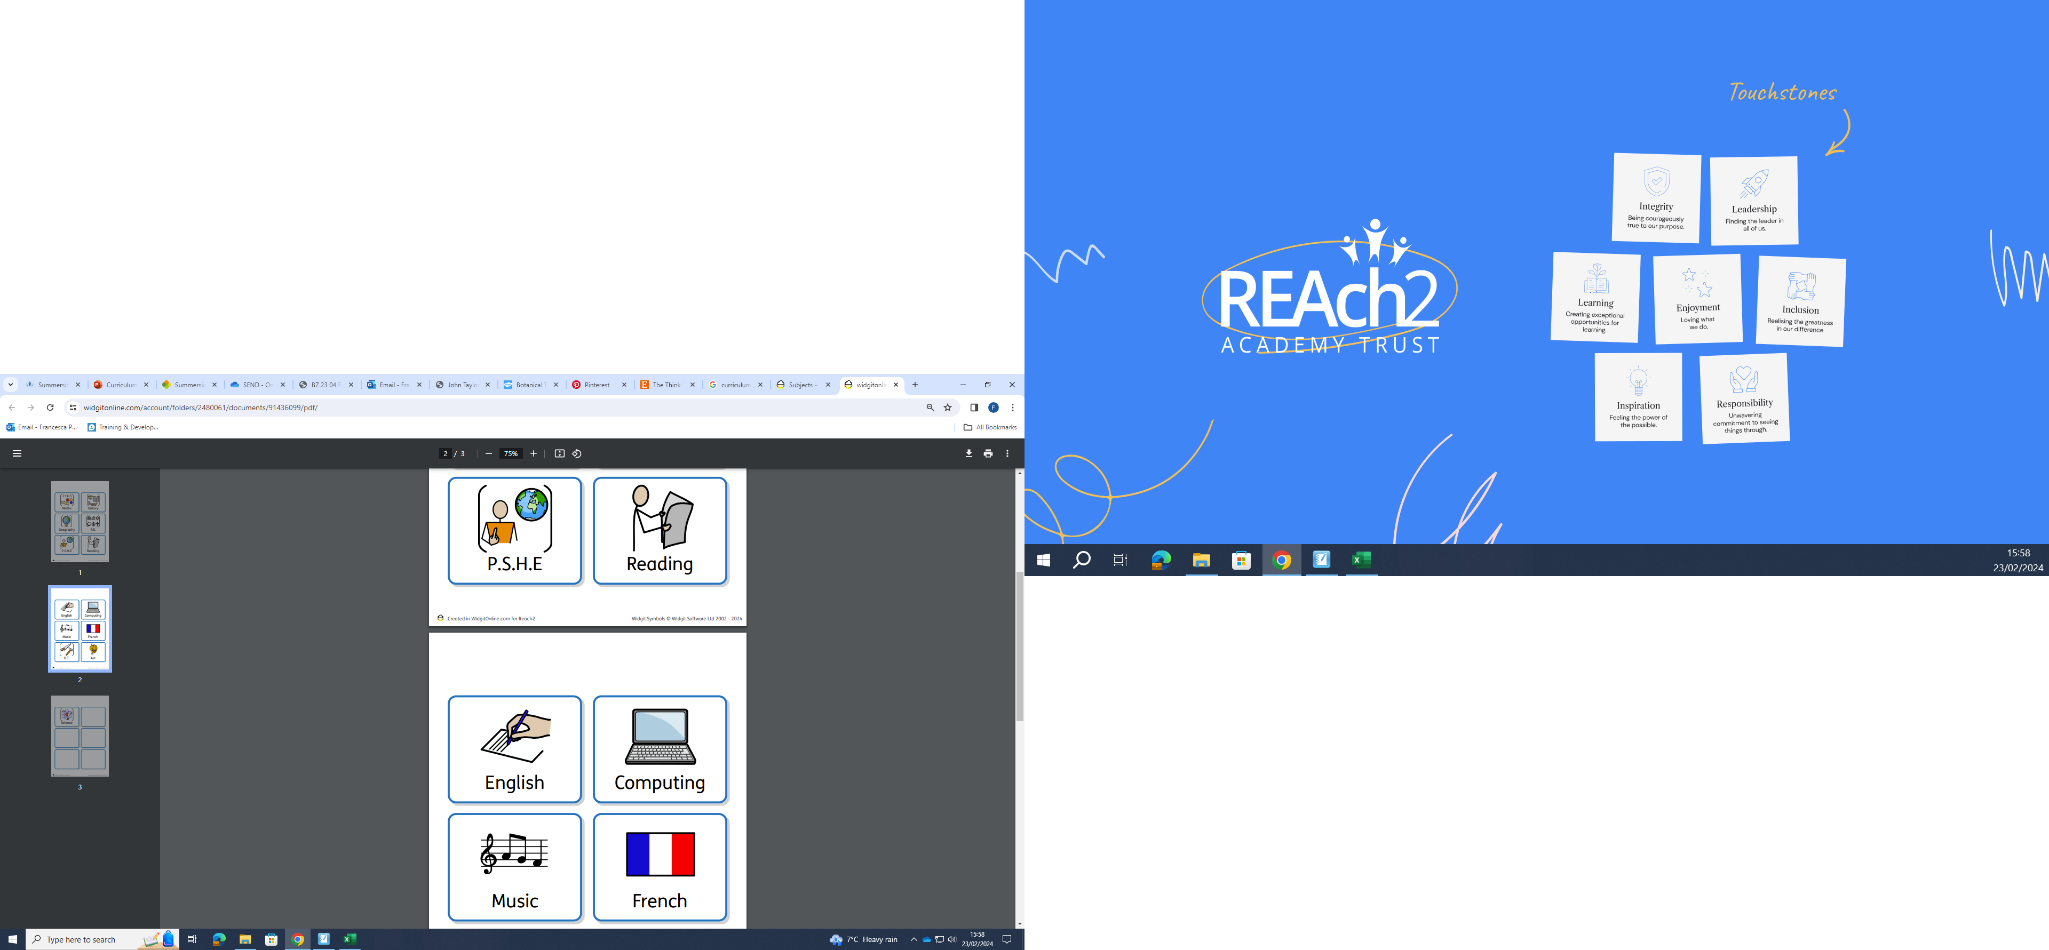
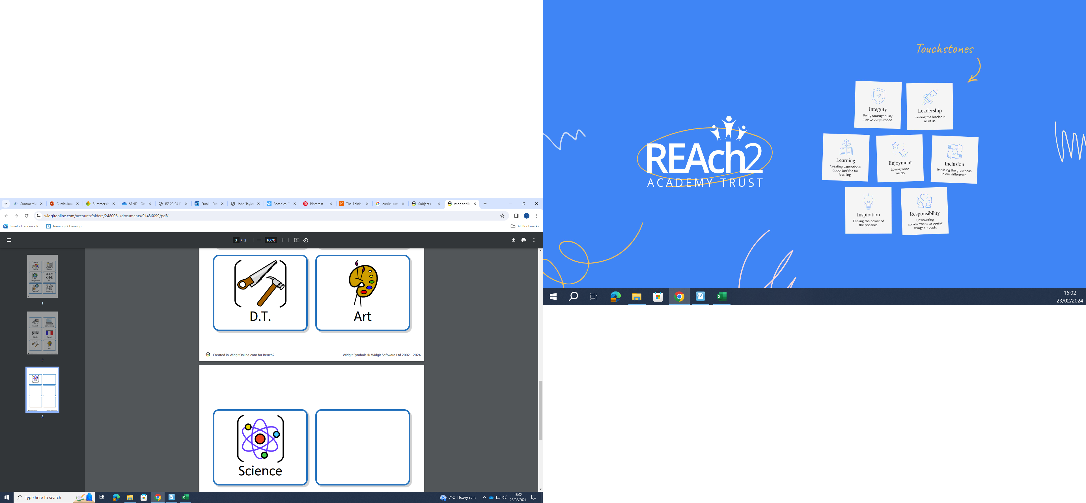
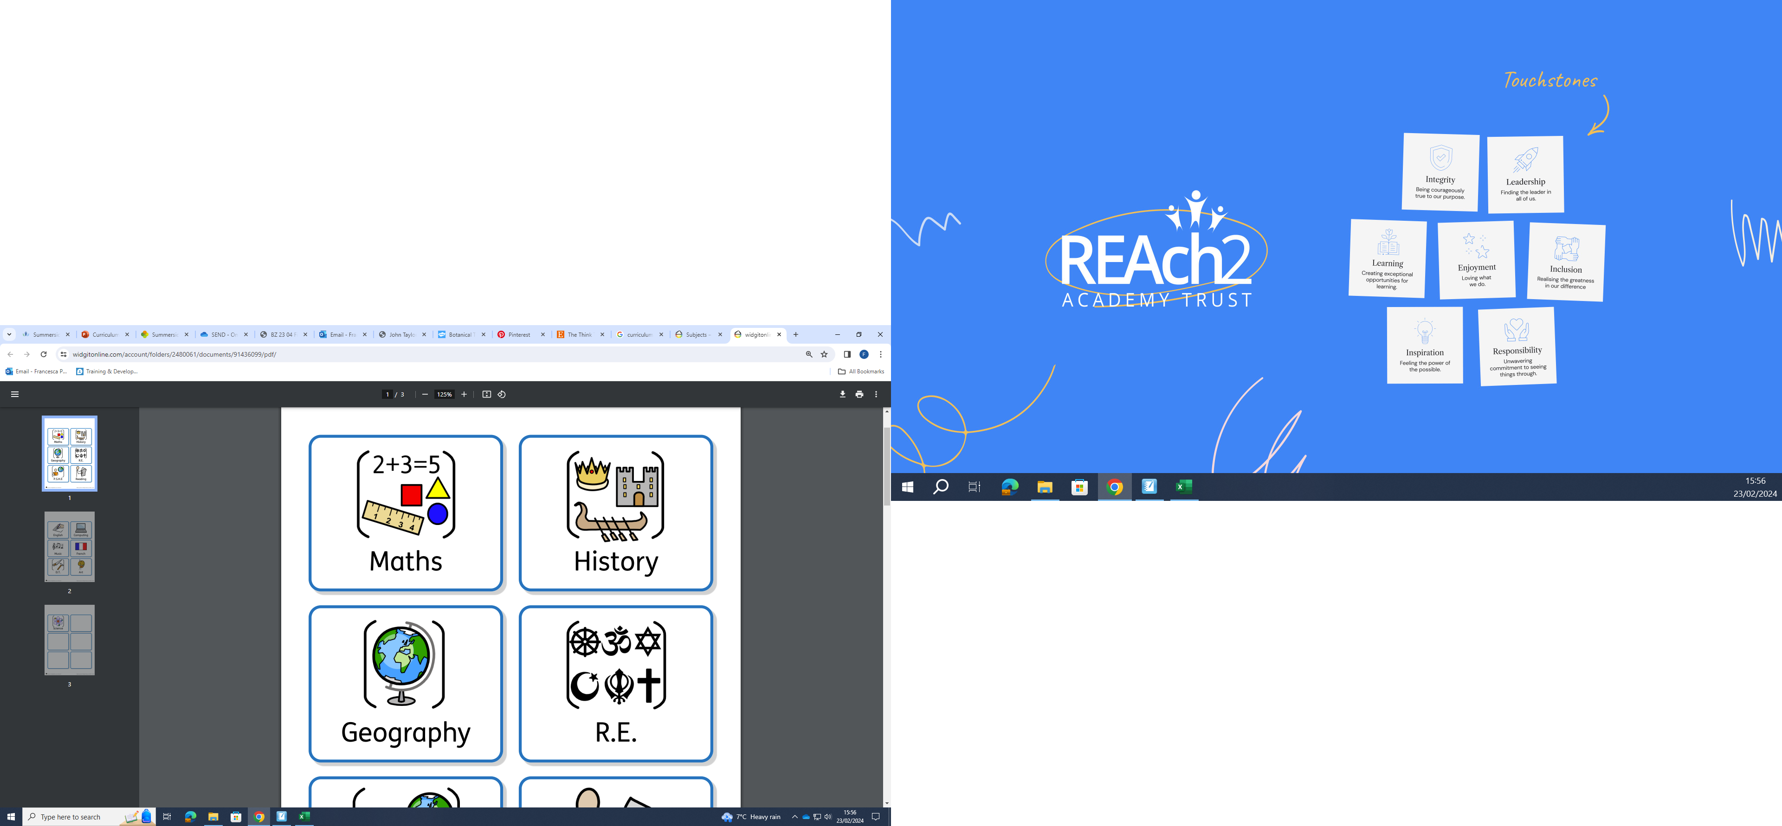
Summerside
Curriculum Maps
The following slides contain information to parents & carers about the different topics that your children will be learning this term. (Summer 1)
Please explore the maps with your children and ask them about their learning as the term progresses.

Slide 2
Nursery Autumn 1
Curriculum overview
All About Me
Communication and language
We will teach and support children to:
Communicate their basic needs to others.
Talk about likes and dislikes.
Talk about people special to them.
Talk about the similarities and differences between people/the environment e.g. Homes.
Talk about their feelings.
PSED
We will teach and support children to:
Settle in and know routines and rules.
Develop confidence and independence to explore resources and play with others fairly.
Learn to share resources and ideas for play.
Begin to value their own identity and others being different from themselves.
Key Texts
There's Only One You
All People Are Beautiful
Love Makes a Family
This is Me!
All Kinds of Homes
Sometimes
Maths
Match, sort and compare
Measure and pattern
Number
Creative Development
We will teach and support children to:
Explore and name a variety of tools and materials to be able to mark make, draw, paint, print, collage, build, model and colour mix.
Represent themselves and family /Draw or Paint, small world and imaginative role play using Mini Me's.
Create Collective projects, such as hand-prints or foot-print big scale Dislays.
Literacy
We will teach and support children to:
Phonics/ Aspect 1
Be able to Distinguish between different environmental and instrumental sounds.
Comprehension, Writing and Reading:
Give meaning to the marks they make to represent their thoughts, names, drawings.
Begin to recognize their name.
Share books and reading behaviours; how to handle them, turn pages, alert to print and illustrations to inform the text.
Understanding the world
We will introduce the children to begin to know about:
Day names
Weather
The season of Autumn
To explore the schools outdoors natural environment, mud kitchen and school gardens and field using the plants growing there and the natural animal life.
Physical development
We will

Slide 3



Reception Autumn 1
Curriculum overview
This is me
Communication and language
We will take part in class discussions and
discuss our feelings and what makes us happy and sad
talk about who is important to us
listen to and join in with songs and rhymes
RE/PSHE
RE: We will talk about our families, friends and role models and listen to stories about Moses and Jesus.
PSHE: We will discuss how to recognise and manage feelings, how we feel at school, our rights and responsibilities and how it is good to be kind.
Key Texts
The Colour Monster goes to school
Super Duper You
Coming to England
Funnybones
What will I be?
Little Red Riding Hood
Maths
Match, sort and compare
match objects and pictures
identify a set
sort objects and create sorting rules
compare amounts
Measure and pattern
compare size and mass and capacity
copy and continue simple patterns
create simple patterns
Number
find, subitise and represent 1,2 & 3
Creative Development
We will
explore and select materials and tools to create different effects
create self-portraits and family portraits
use junk modelling to create buildings
learn and sing songs and rhymes
Literacy
We will
practice writing our names
have daily phonics lessons learning to hear and say the initial sounds in words
learn letter sounds
retell familiar stories and create story maps
identify words that rhyme
draw pictures and write labels
Physical development
We will develop fine motor skills including using small tools to cut, paint and eat lunch.
We will develop gross motor skills in the outdoor area using bikes and equipment and in PE lessons.
Understanding the world
We will
learn to draw information from a simple map
comment on images from the past
talk about our immediate family and community
notice and talk about seasonal change and go for an autumn walk

Slide 4

Year 1 Autumn 1
Curriculum overview
RE/PSHE
RE: What do Christians believe about God?
PSHE: We will discuss when and where we feel special and safe, how to make our class a safe place and recognise how it feels to be proud of an achievement.
Maths
Numbers to 10
sorting, counting and representing objects
count, read and write forwards and backwards from any number to 10
count one more and one less
compare groups of objects using language such as equal, more/greater, less/fewer
introduce < > and = symbols
compare and order numbers
Addition and Subtraction
Use the part-whole model
Use the additional symbol
Learn number bonds to 10
Use ordinal number 1st, 2nd, 3rd) compare and order numbers
Geometry
Name simple 2d and 3d shapes.
Key Texts
Love You Always
The Squirrels who Squabbled
Art & Design Technology
This term we will be learning all about self portraits. We will learn what abstract art is and learn about the artist Pablo Piccasso.
English
In English we will
Reading
have daily Read Write Inc. phonics lessons, focusing on phonics, reading and writing.
learn letter sounds, blending sounds to read words, segmenting sounds to spell words.
learn to read common exception words, e.g. are, some, and spelling these accurately.
In class we will read fiction and non fiction books about seasons including Love You Always and The Leaf Thief.
Writing
say what we want to write aloud before writing it
write labels and sentences about seasons.
write sentences using capital letters, finger spaces and full stops.
Use colourful semantics to help us build and write sentences.
Geography
This term we will learn about the local area. We will learn about where we live in the world and recognise the human and physical features around us.
Music:
In our topic; My favourite things, we are learning to keep a steady beat. We will learn to move our bodies in time to music.
Science
In science we will
Observe changes across the four seasons - go for an autumn walk in Coppetts Wood
Observe how the length of a day varies across the seasons
PE
We are performing dances using basic movement patterns.

Slide 5






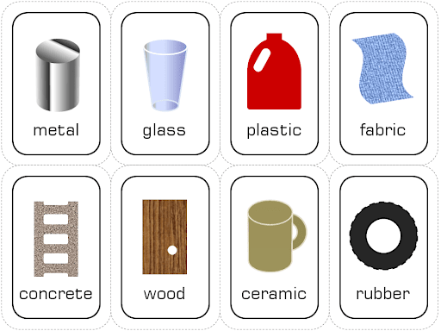
Year 2 Autumn 1
Curriculum overview
Humanities – History / Local area
In History this term we will:
Identify historically significant locations in our area.
Investigate an historical location in our area.
Understand how places change.
Learn about significant individuals in the area.
Understand how transport has changed in Barnet over time.
RE/PSHE
RE: Why do Sikhs admire their Gurus?
PSHE: Being me in my world
Key texts
Aliens Love Underpants
Science – Materials / playground games
To identify and describe the properties of materials used for different balls.
To predict and observe which ball will bounce the highest.
To identify and describe the properties of materials used for different bats.
To use their understanding of the properties of a material to make predictions.
To apply their understanding of the properties of materials to solve problems.
Maths - Place value
Numbers to 20
Count objects to 100 by making 10s
Recognise tens and ones
Use a place value chart
Partition numbers to 100
Write numbers to 100 in words
Flexibly partition words to 100
Write numbers to 100 in expanded form
10s on the number line to 100
10s and 1s on the number line to 100
Estimate numbers on a number line
Compare objects
Compare numbers
Order objects and numbers
Count in 2s, 5s and 10s
Count in 3s
English
Key Texts: Aliens Love Underpants
Outcomes: To retell the story with different characters and their own ending.
Computing
Computer systems and networks / what is a computer?
Music
French songs
PE
Outdoor – Fundamental movements through tag games
Indoor – Principles of dance
Art
Shaded portraits – we will be exploring different techniques and looking at a range of sources to create our own self portraits.

Slide 6

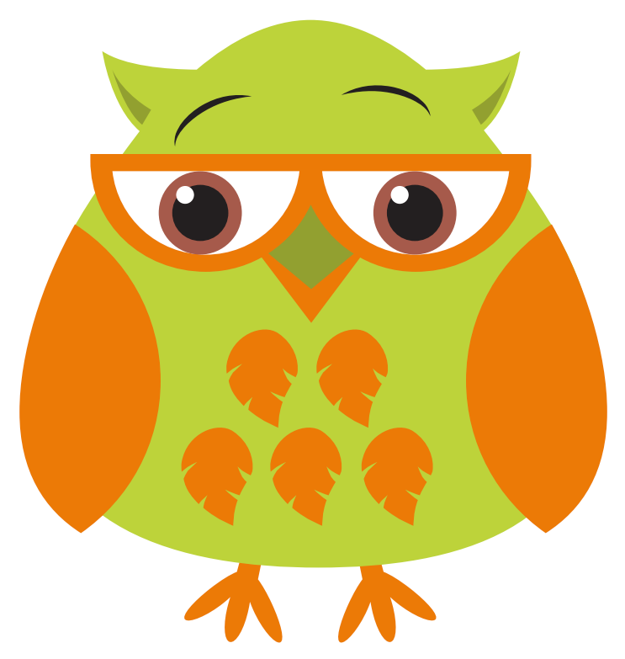

Year 3 Autumn 1
Curriculum overview
Maths:
Numbers to 1000:
Counting in hundreds, tens and ones, comparing and ordering numbers, counting in fifties, recognising number patterns and counting in fours and eights.
Addition and subtraction:
Add and subtract numbers mentally, including:
A three-digit number and ones.
A three-digit number and tens.
A three-digit number and hundreds
Add and subtract numbers with up to three digits, using formal written methods of columnar addition and subtraction.
Estimate the answer to a calculation and use inverse operations to check answers.
Solve problems, including missing number problems, using number facts, place value, and more complex addition and subtraction.
RE/PSHE
RE: What is the best way for a Jew to lead a good life
PSHE: Being Me In My World
Humanities – Geography – Countries, Counties and Cities
We will be finding out about:
Name and identify where they live
Identify human and physical features of an area
Name and locate the four countries of the United Kingdom
Name the capital cities of the four countries of the United Kingdom
Name and locate the surrounding seas of the United Kingdom
PE
Netball
Music
Music Express – linked to the Geography topic.
Understanding pulse and rhythm and exploring beats in a bar.
Key Texts
The Twits
Computing:
In Computing, we will be learning to program. We will be learning to:
Use a variety of inputs
Use the ‘repeat’ (loop) command within a series of instructions.
Use the ‘if… then’ (conditional statement) command within a series of instructions- Write a simple program in Logo to produce a line drawing.
Write a program to reproduce a defined problem, e.g. geometric shape/pattern.
Art & Design/Design Technology
-Creative collages
Science
In Science, we will be focusing on forces and magnets, which includes:
Comparing how things move on different surfaces.
Notice that some forces need contact between two objects, but magnetic forces can act at a distance compare and group together a variety of everyday materials on the basis of whether they are attracted to a magnet.
Identify some magnetic materials.
French - J'apprends le francais/I'm learning French
Children will be able to:
Introduce themselves, say how they feel and have a wider appreciation for the countries where the language is spoken.
English
Key Text: The Twits
Outcomes: Diary entry

Slide 7
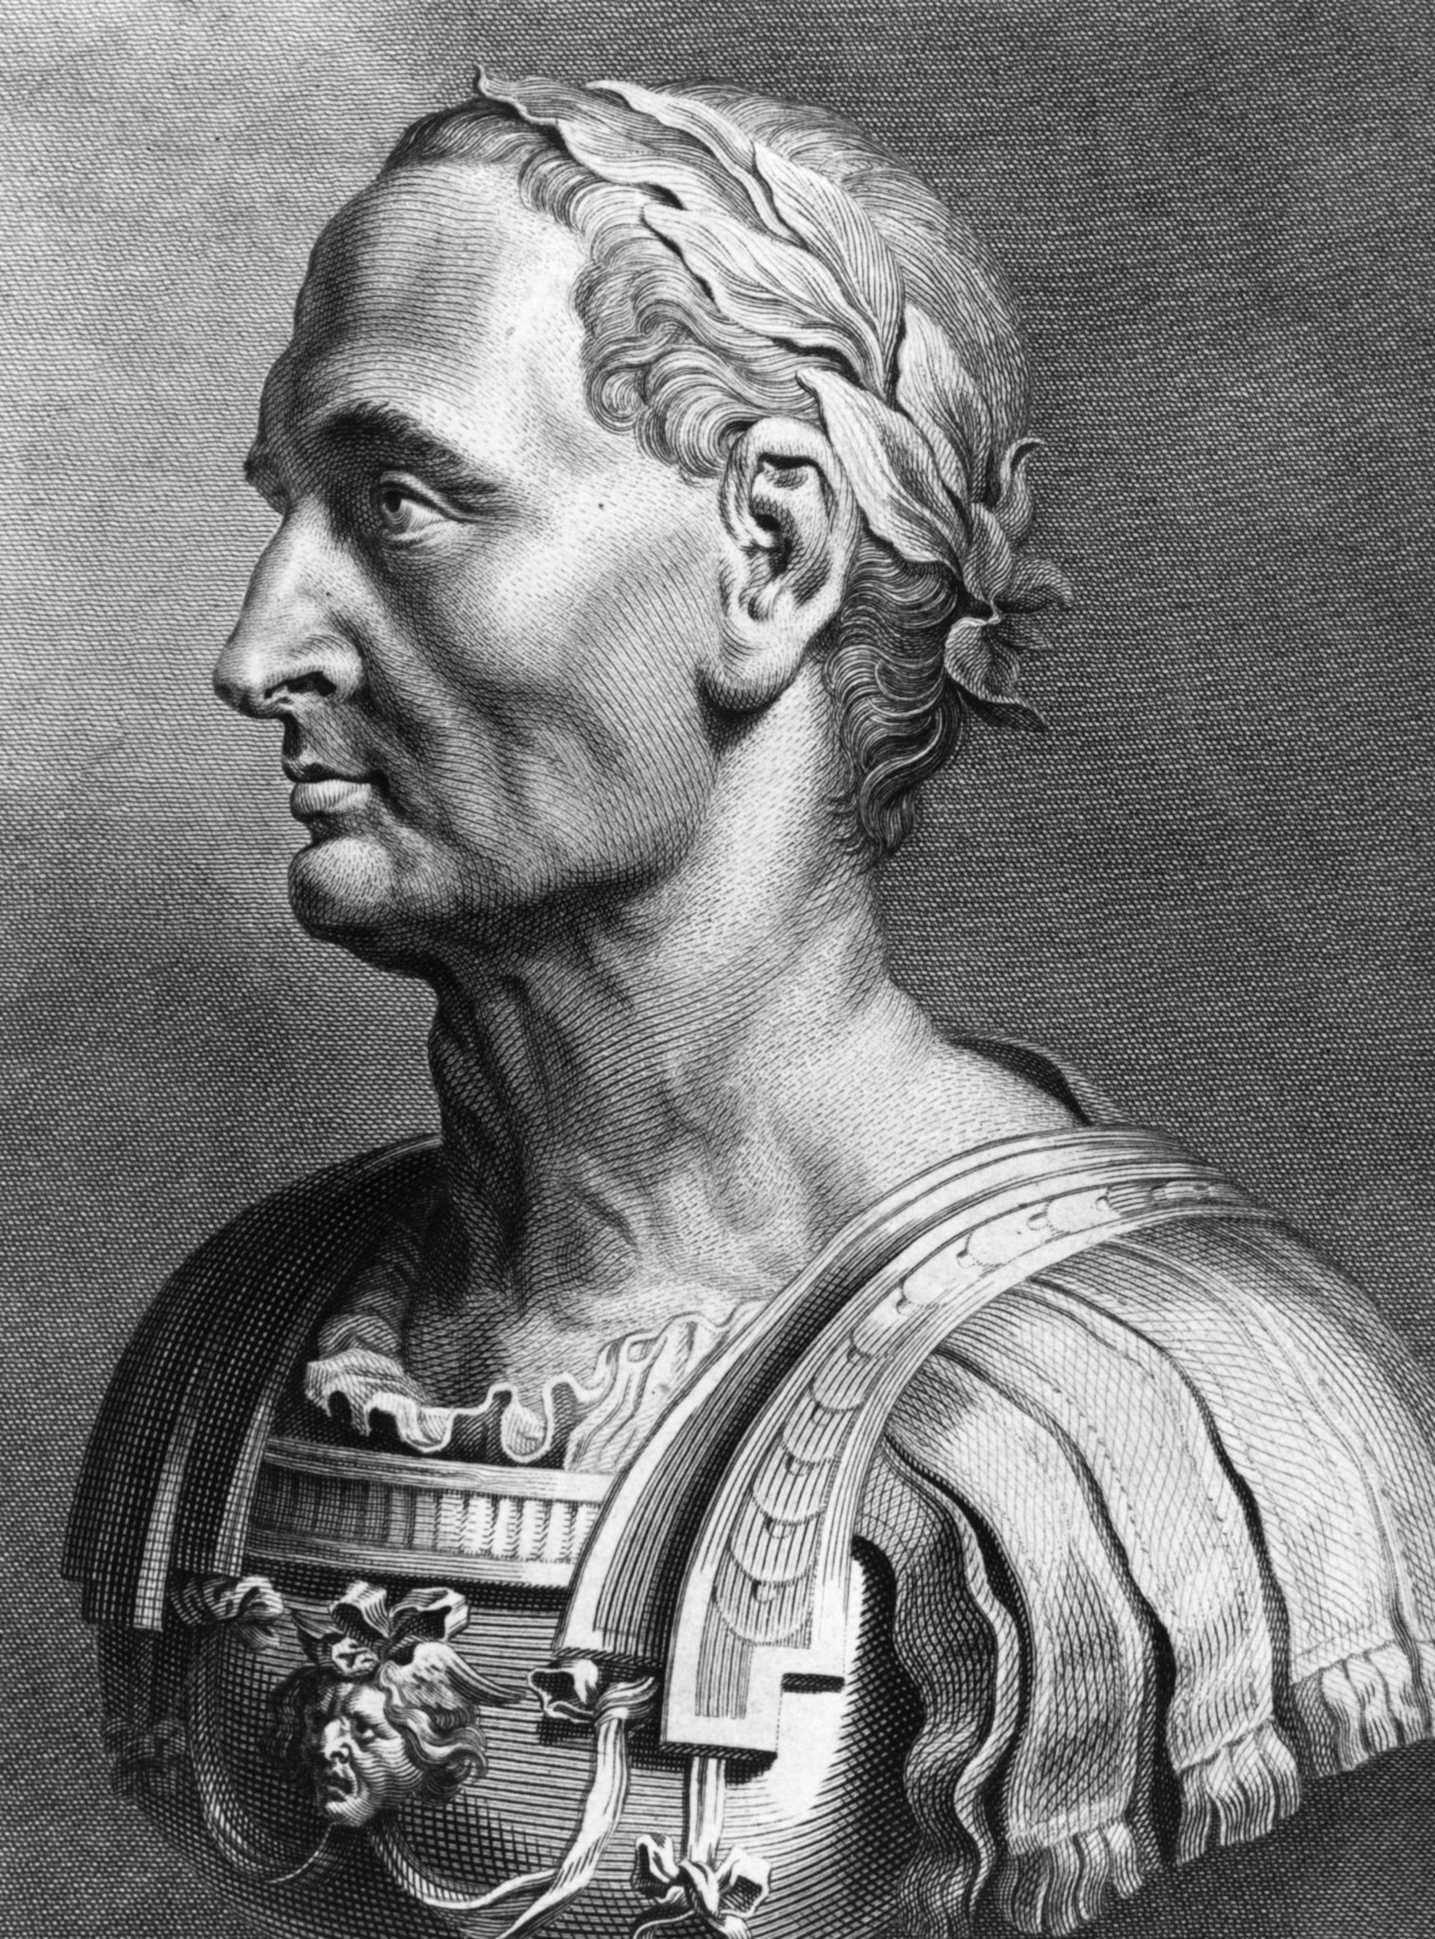





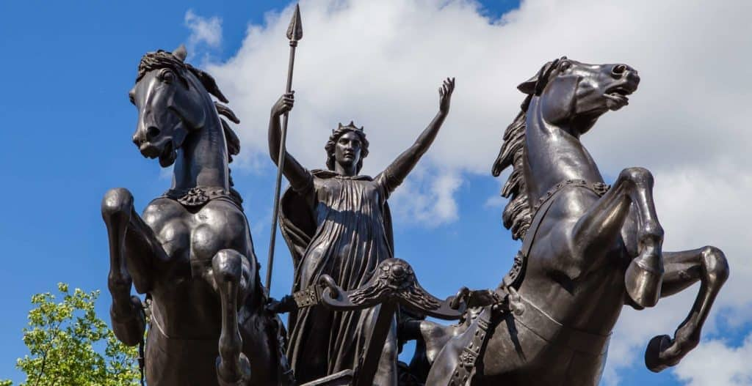
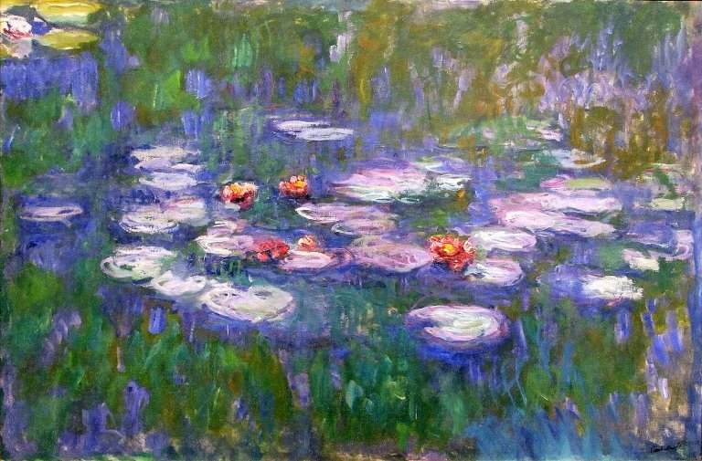
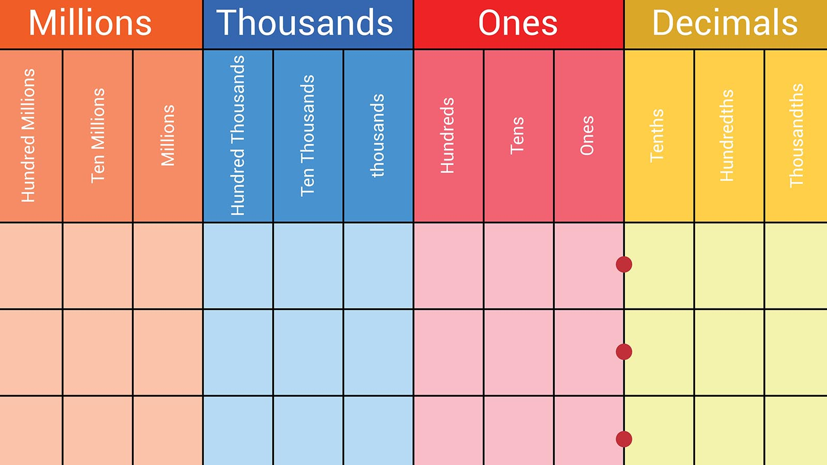
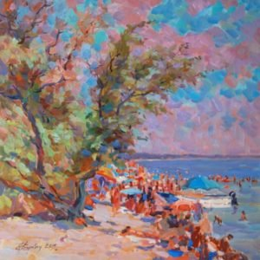

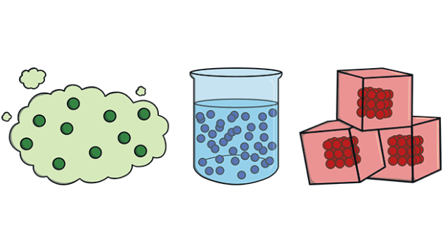
Year 4 Autumn 1
Curriculum overview
History – Ancient Rome
To understand what is meant by Roman Empire.
To understand what is unique about the Roman Army
To learn about how Queen Boudicca challenged the Romans during their occupation of Britain.
To learn about Gods and Goddesses in Roman Religious belief.
To learn what life was like in Roman Britain
To understand how the Romans have influenced our lives today.
RE/PSHE
RE: Does praying at regular intervals help Muslims in their everyday lives?
PSHE: Being Me in My World
Key Texts
Music -
Learn a new song, singing in time and in tune while following the lyrics.
Identify motifs aurally and play a repeated pattern on a tuned instrument.
Create and performing a motif, notating it with reasonable accuracy.
Maths
Place Value
Number lines
Ordering and comparing numbers
Rounding
Addition and Subtraction
Adding up to 4-digit numbers
Subtracting up to 4-digit numbers
Art & Design
Art: Impressionist Paintings
Claude Monet, Pierre-Auguste Renoir
-To know what the Impressionist Movement entailed
-To understand the characteristics of Impressionist art
-To learn what perspective is
-To understand how background and foreground influences perspective
-To know how to use acrylic paint
English
Key Texts: Escape From Pompeii and Voices of Rome and Empire's End - A Roman Story
Outcomes:
Narrative Recount
Diary Entry
Science – States of Matter
To describe the properties of solids, liquids and gases and know the processes that cause something to change from one state to another.
MFL - Je me présente / Presenting myself
Children will be able to:
Count to 20. Tell you where they live.
Tell you their nationality
Understand basic gender agreement rules.
Computing – E-safety and Coding on Scratch.
PE
Principles of Dance and Invasion Games

Slide 8
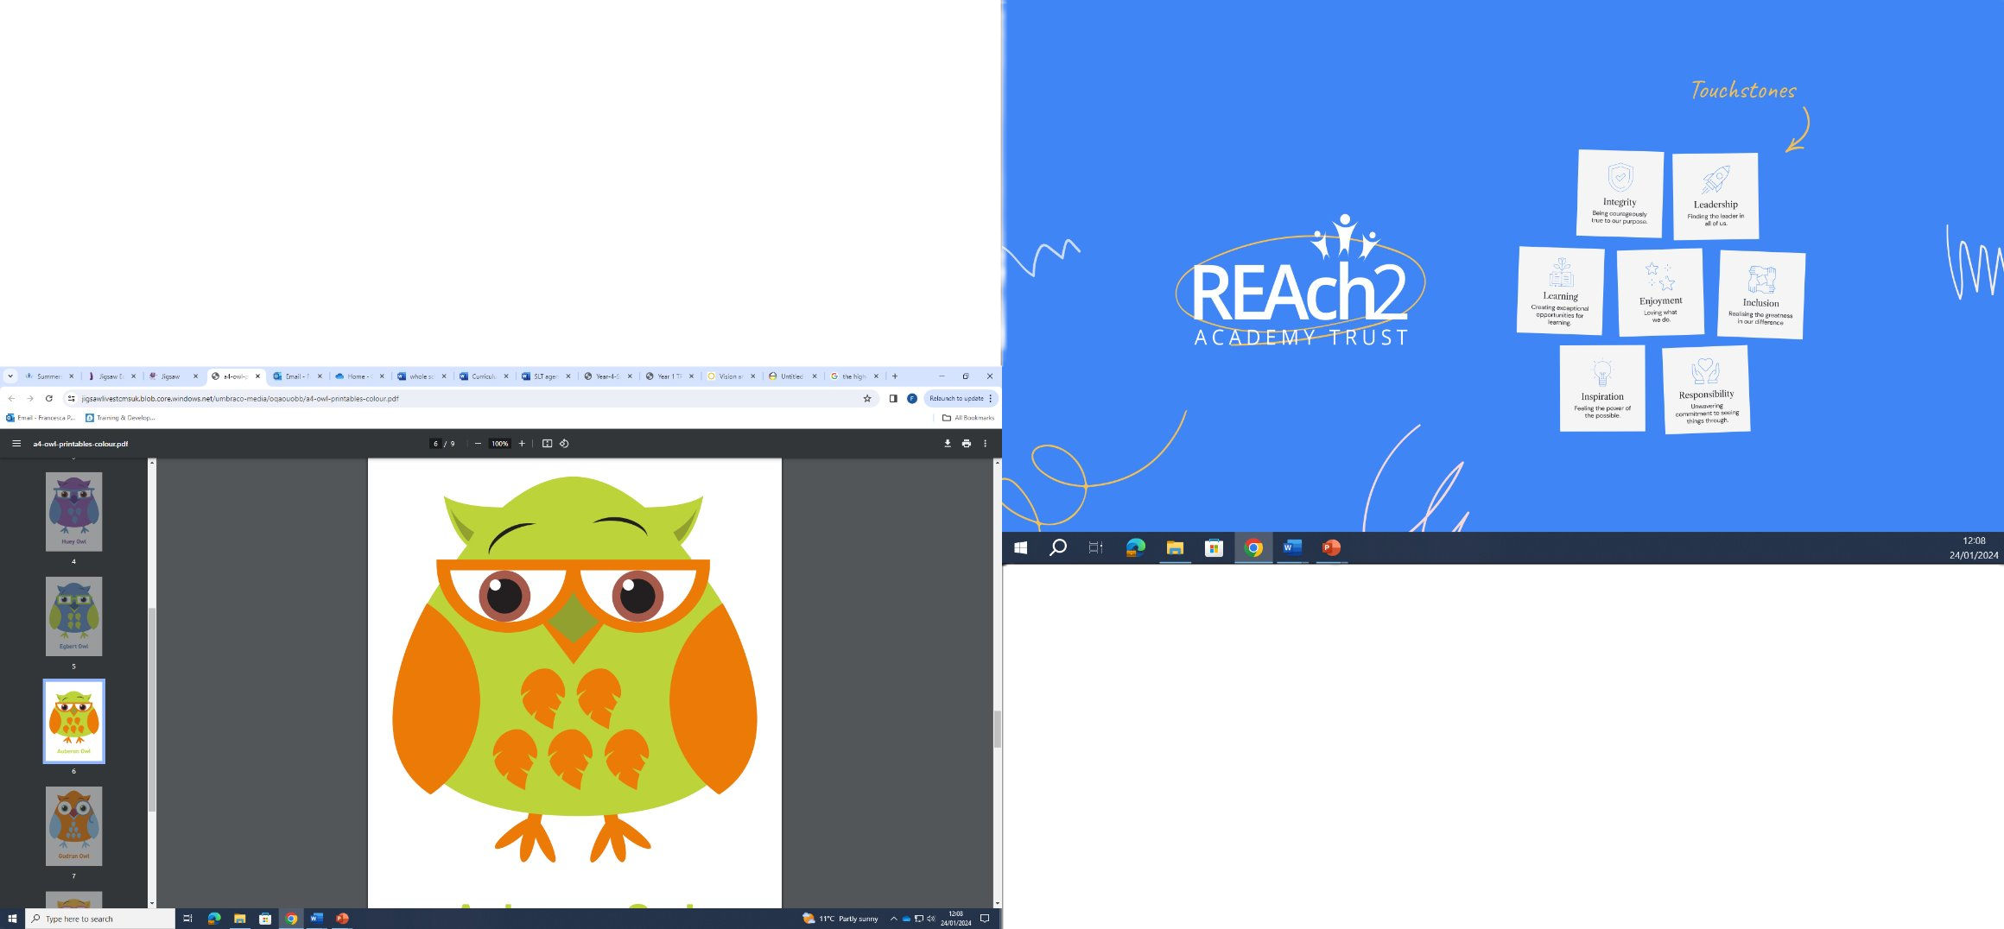


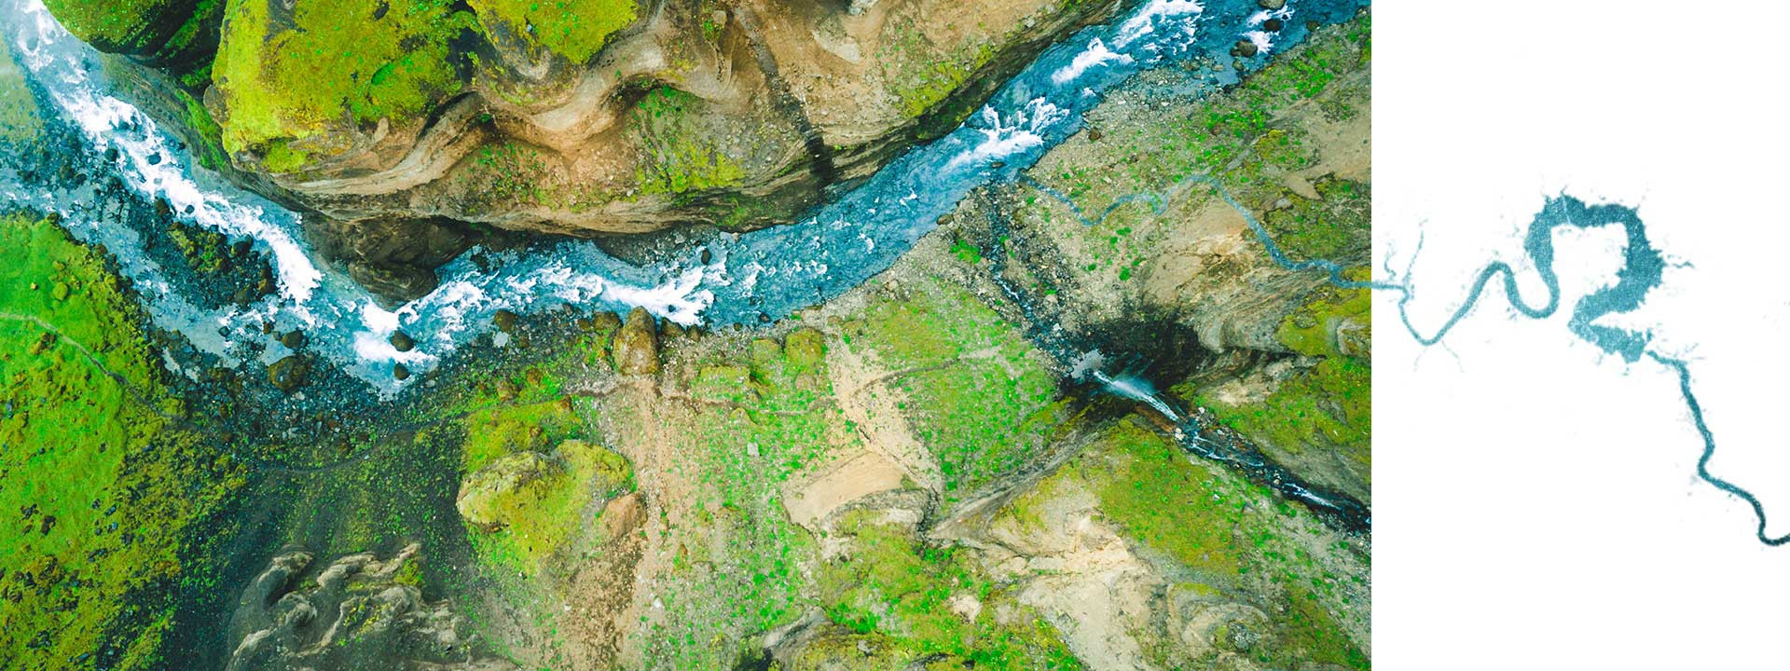
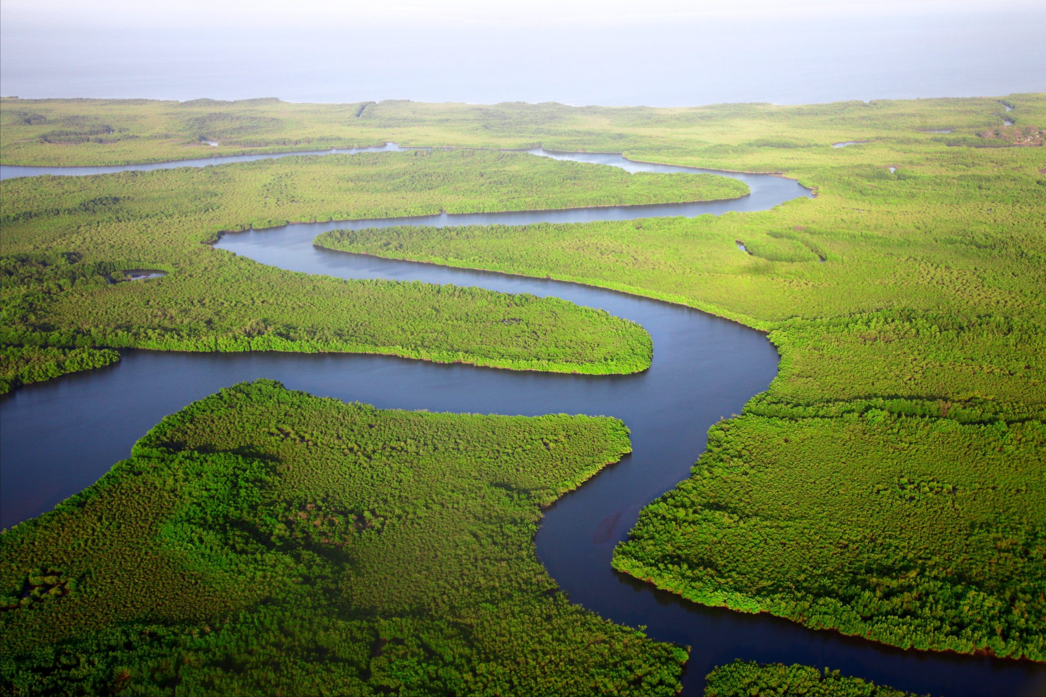


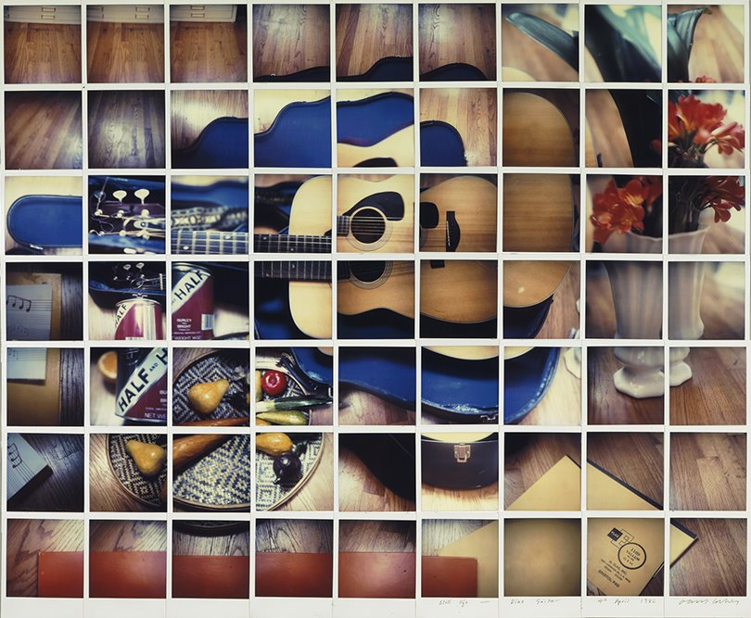
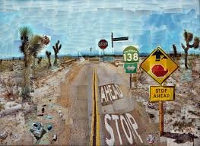

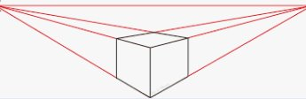
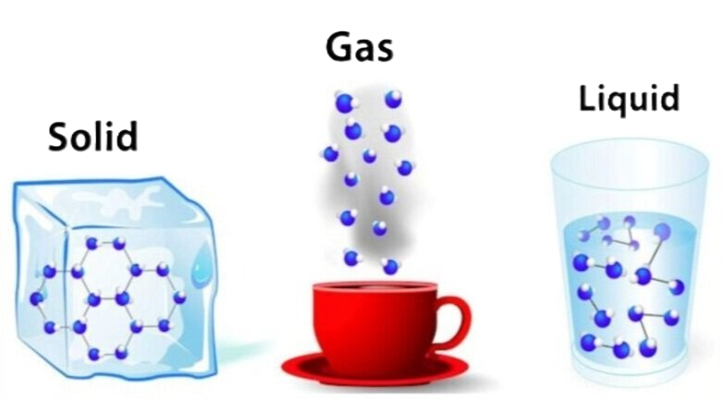



Year 5 Autumn 1
Curriculum overview
Geography
We will be studying rivers in the U.K. and major rivers around the world, including the Amazon, Nile, Mississippi, Ganges and the Volga. We will learn about the river's course and the water cycle and will look at the difference between freshwater and saltwater. We will develop skills in map reading and using compass points for navigation.
RE: We will learn what is the best way for a Sikh to show commitment to God and will talk about different Sikh practices, ranking them according to which we feel show the most commitment whilst recognising that all are important
PSHE: Being Me in My World We will consider how to face challenges, how we can be good citizens and make our school community a better place and think about our rights and responsibilities.
Key Text
Music: Life Cycles Singing in two and three parts, we will accompany a song with tuned and untuned instruments and compose and perform together. We will also create musical effects using contrasting pitch and learn about the music of early opera.
Maths
Place Value:
Roman numerals to 1,000
Numbers to 10,000
Numbers to 100,000
Numbers to 1,000,000
Read and write numbers to 1,000,000
Powers of 10
10/100/1,000/10,000/100,000 more or less
Partition numbers to 1,000,000
Number line to 1,000,000
Compare and order numbers to 100,000
Compare and order numbers to 1,000,000
Round to the nearest 10, 100 or 1,000
Round within 100,000
Round within 1,000,000
Addition & Subtraction
Mental strategies
Add whole numbers with more than four digits
Subtract whole numbers with more than four digits
Round to check answers
Inverse operations (addition and subtraction)
Multi-step addition and subtraction problems
Compare calculations
Find missing numbers
English
Key Text: Ice Trap!
Outcomes: Setting Description and Diary Entry
Art – Digital River Collage
Using computer technology and the artistic skills of overlay, composition, depth and perspective we will create river landscapes. We will also learn to evaluate our work.
Science: Properties of materials and reversible changes: We will gain an understanding of the properties of different materials, including investigating conductivity. We will discuss how to separate mixtures using filtering, sieving and evaporation and explore which changes are reversible and how some changes result in formation of new materials
MFL We will learn the names of pets in French, how to say which pet we have and what its name is, and what pets we do not have.
Computing
Computing systems and networks: Search engines
Understanding how search engines work and developing searching skills to find relevant and accurate information online.
PE - Outdoor PE will be Basketball and Football, focusing on learning the rules and understanding the game, plus the skills of movement, passing and catching.
Indoor PE will be Principles of Dance, learning how to demonstrate different levels of Dance: high, middle and low.

Slide 9

Year 6 Autumn 1
Curriculum overview
Maths
Read, write and compare numbers up to 10,000,000
Round numbers
Negative numbers
Formally multiply up to 4 digit numbers by 2 digit
Formally divide up to 4 digit numbers by 2 digit (short and long division)
Identify common factors, common multiples and prime numbers.
Calculate using the four operations (BODMAS)
PSHE: Being Me in My World
R.E: Our Enquiry Question this term is:
What is the best way for a Buddhist to live a good life?
Key Texts
PE: Outdoor: Invasion Games
Indoor: Dance
Humanities – History, WW2
Understand and sequence the events leading up to the war
Understand propaganda and rationing
Understand why evacuation occurred
Know the events of the Blitz
Understand the role of women in the war
Know the significance of VE day
Music: Songs of WW2
Use musical and comparative language in discussion.
Follow the melody line.
Follow the scores with a good sense of timing, showing that they understand which section of pitch they are singing.
Sing the correct words at the correct time.
Recall the counter-melody line.
English
Key Texts: Star of Fear, Star of Hope
Outcome:
Narrative recount including a flashback from Lydia's point of view
Science – Light
Know that light travels in straight lines
Investigate shadows
Objects are seen because they give out of reflect light.
How we see objects out of sight
Exploring the light spectrum.
Computing:
Computer Systems and Networks: Bletchley Park and the History of Computers
How to ensure a password is secure
Historical figures within Computer Science
Develop an idea for a computer of the future
Produce an audio advert with simple edits.
MFL – À l'école (At School)
Pupils will learn vocabulary for 10 school subjects in the foreign language. Pupils will talk about the subjects they like and dislike at school and at what time/day they study various subjects.
Design Technology – Take a Seat
We will learn about the development of cushion design through the ages, before the children design their own cushion, thinking about appearance, comfort and practicalities. Children will learn simple sewing techniques and then create their design.

