Slide 1

E-safety at Summerside Primary School
Tuesday 26th April

Slide 2









What are your children doing online?
Playing games?
Making friends?
Talking to people?
Sharing?
Searching?
Homework?

Slide 3
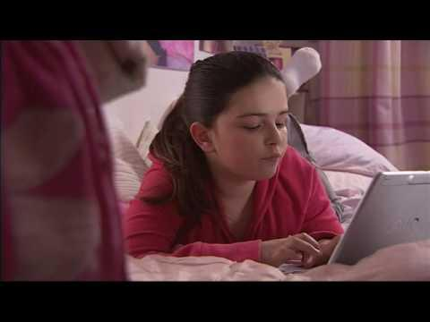
Watch this and see what the children in this situation think.

Slide 4
This is how the children reacted!
Where are the adults?
She shouldn’t put the information on the website in the first place.
I wouldn’t leave the door open for strangers to come in.
I am angry
I am scared.

Slide 5

Top tips for gaming
Check the age rating on the box
It is for their safety!

Slide 6

Top tips for gaming
At this age you need to be aware of the games your child plays and the different things they can do on them.
The easiest way to find out about the games your child is playing is by joining in!
Get your child to teach you how to play the game and, if they are happy, play alongside them.
Who knows, you might even win!
You might want to ask them:

Slide 7

Top tips for gaming
Why they like the game?
What’s so fun about it?
Who uses it at school?
What’s the name of their character?
Who can you talk to?
Who are their friends in the game?

Slide 8




Slide 9

These games are suitable for children but they still need supervising!

Slide 10
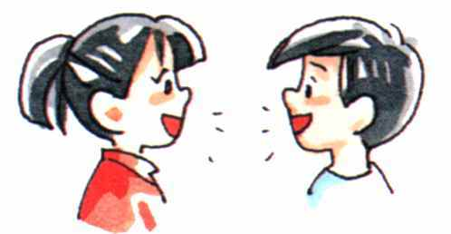
Talking to people
Children use the internet to talk to people in a number of different ways: emailing, instant messaging, webcam and chat rooms. Chatting online can feel different to chatting face-to-face. It can be easier to say and reveal things that you wouldn’t in the real world.
At this age, you should make sure that you are happy with the people that they talking to so you can help to protect them from any risks they might encounter

Slide 11

Instant Messaging
Instant messaging (IM) is instant text chat between two or more people. This tends to be private un-moderated chat. You can build a list of ‘friends’ or ‘buddies’ that you can chat to, they can see when you are online and start conversations with you. It is important for children to know how to manage this list, for example by blocking contacts they don’t want to talk to.

Slide 12

Instant Messaging
Windows Live Messenger is a popular IM service; however, many sites, including Facebook, provide instant messaging.
Should primary school children have a facebook account?

Slide 13

Webcams
Webcams let you see the person you’re talking to while you’re chatting.
Services like Skype are very popular and free. This can be a fun way for children to chat to each other; however, it is important to remember that what appears on webcam can be recorded and shared with other people in ways that you wouldn’t want.

Slide 14

Chat Rooms
A chat room is a forum where groups of people meet to chat online – this can sometimes be about a particular topic, or can be friends meeting to discuss something.
Sometimes chat rooms are moderated; this means that someone, or a computer program, is looking out for inappropriate language or behaviour.

Slide 15

Should my child have an email account?
Your child may ask to have their own email account. You need to think about whether they are old enough and mature enough to have an account that will provide them with some independence online, such as giving them the ability to register with websites.
If your child is setting up an account, here are some simple steps you can take to help them use it safely and securely.

Slide 16

Tops Tips
Set up the account with them – this will give you a good idea of what personal information has been asked for and the functionality of the account.

Slide 17

Tops Tips
Check moderation possibilities – popular services such as Hotmail have parental controls to assist you with the moderation of the account. Some allow you to have a family account or moderation rights. This way you can see the emails received and the sites your child is registering on too. If this is not possible, you can share the password to the account, especially for younger age groups; this way you can moderate if you feel necessary.

Slide 18


Tops Tips
Ask your child to only email people they know and trust in the real world.
Ask them to never click on emails from people they don’t know or links they don’t recognise, as they could contain a virus which will harm the computer, or take them to a site which is inappropriate.

Slide 19
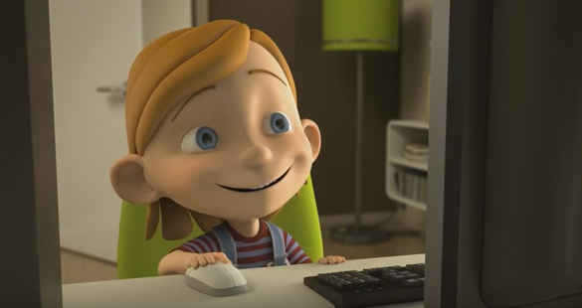
Look what could happen and how he was helped!

Slide 20
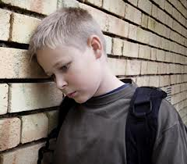
Tops Tips
Encourage them to tell you if they see anything that upsets them online, because you can help them.

Slide 21


Report it
http://ceop.police.uk

Slide 22

Screen time allowances
How long do you want your children to be staring at a screen?
You make the rules and stick to them!

Slide 23
Sleep is needed!
Age in years | Recommended amount of sleep | Asleep by... | Awake by...
6 | 10.75 hours | 8.15 pm | 7.00 am
7 | 10.50 hours | 8.30 pm | 7.00 am
8 | 10.25 hours | 8.45 pm | 7.00 am
9 | 10 hours | 9.00 pm | 7.00 am
10 | 9.75 hours | 9.15 pm | 7.00 am

Slide 24
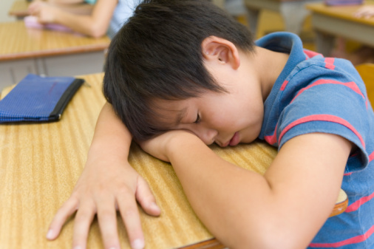
Being technology literate is important but being awake to learn is also important!

Slide 25


Any Questions?

Slide 26

Please complete the evaluation form.

